Slide 1
Mitosis
Lecture 19

Slide 2
Objectives
Define/describe/know the terms mitosis, aster, spindle formation, mitotic centers/spindle poles, polar microtubules, chromosomal microtubules, astral microtubules, kinetochores, metaphase plate, and daughter chromosomes
Be able to describe briefly the phases of mitosis: prophase, prometaphase, metaphase, anaphase, telophase
Understand cytokinesis

Slide 3
Mitosis
Mitosis is the series of events that parcels out the replicated DNA of the mother cell to two daughter cells
Mitosis is actually a continuous process, with five phases that flow smoothly into each other
Its duration varies according to cell type, but in human cells, it typically lasts about an hour or less
The purpose of mitosis is to ensure that one copy of each duplicated chromosome are separated into each of the two daughter nuclei

Slide 4
Phases in Mitosis
Five phases describe the cell cycle M phase (mitosis)
Prophase
Prometaphase
Metaphase
Anaphase
Telophase

Slide 5
Important Premitotic Events
Chromosome replication (duplication of DNA) was completed in S phase
Centrosome duplicated usually during S phase
DNA scaffolding and compacting proteins (e.g. histones) synthesized (in G₂) and ready for use in daughter cells
Cell volume has reached a minimum threshold for cell division

Slide 6
Prophase
Preparation of chromosomes for division and formation of spindle
Disintegration of microtubules that make up cytoskeleton
Migration of duplicated centrosomes to opposite ends of nucleus
Condensation (extreme compaction) of chromosomes such that they are visible under light microscope
Starburst: formation of aster ("star") as the beginning of the mitotic spindle with extension of microtubules from polar centrosomes toward middle of cell where

Slide 7
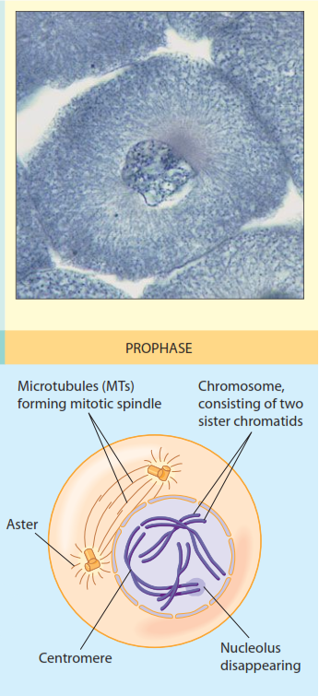
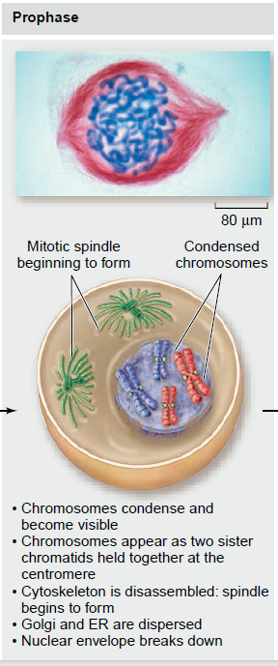
Prophase

Slide 8
Mitotic Spindle Details
The microtubules radiating from the asters at the pole create three kinds of microtubules:
polar microtubules an MT extending from one spindle pole toward the equator of the spindle and connecting with a polar MT from the other spindle pole
chromosomal microtubules an MT extending from individual chromosomes outward toward the spindle poles Chromosomal microtubules are attached to specialized structures on either side of the centromere called kinetochores
astral microtubules short MTs that extend from aster to plasma membrane

Slide 9
Prometaphase
Onset → fragmentation of nuclear envelope
Centrosomes completing movement to opposite sides of nucleus
Chromosomal microtubules insert into kinetochores formed around centromere
Astral microtubules are seen contacting plasma membrane

Slide 10
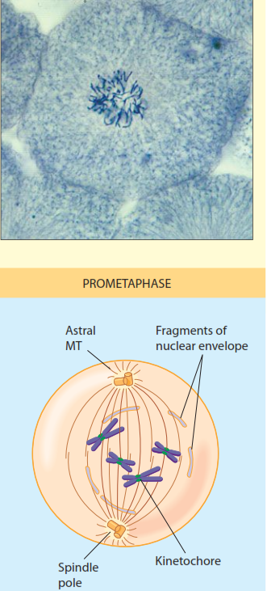
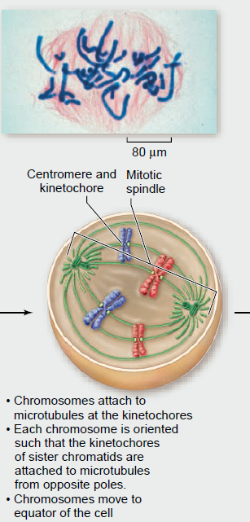
Prometaphase

Slide 11
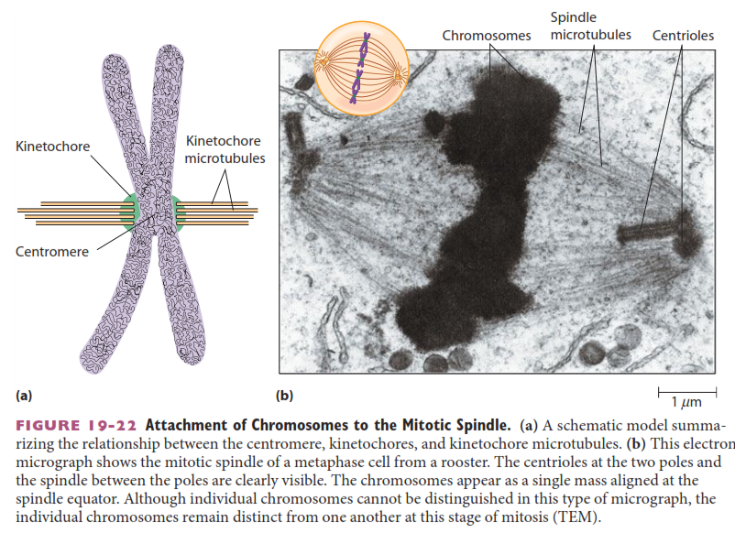
Kinetochore-Spindle Interaction

Slide 12
Metaphase
Onset → fully condensed chromosomes aligned on the metaphase plate
Metaphase plate = plane equidistant between two poles of mitotic spindle
Chromatids are being pulled part (but not visibly) in start of migration to their poles

Slide 13
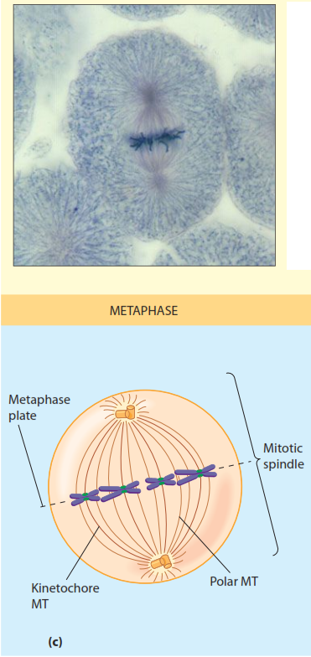
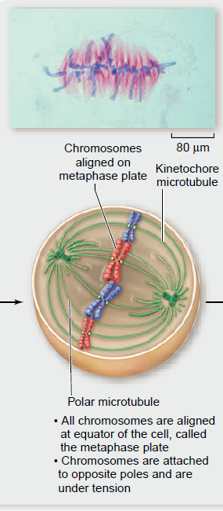
Metaphase

Slide 14
Anaphase
Onset → chromatids visibly pulled apart
Two movements seen (anaphase A, anaphase B):
Chromosome movement to pole
Pole-from-pole separation movement
Rate of chromatid movement = 1 µm/minute
Cells may have diameter of 50-75 µm
Shortest of all phases: a few minutes

Slide 15
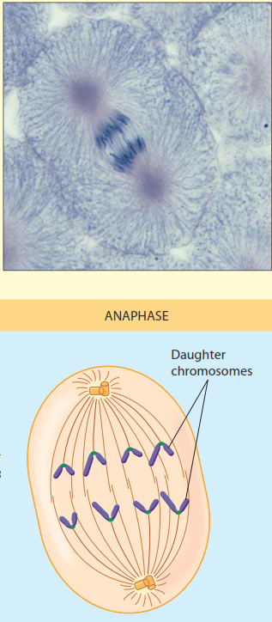
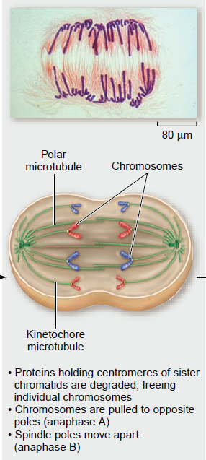
Anaphase

Slide 16
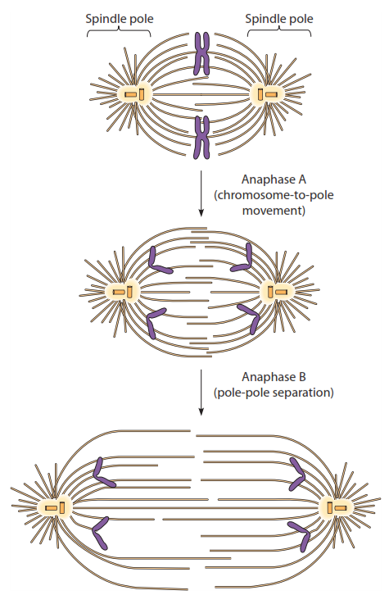
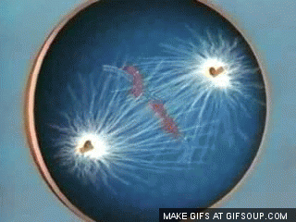
Anaphase Movements
Anaphase A (chromosome to pole movement) and Anaphase B (further pole separation) are shown

Slide 17
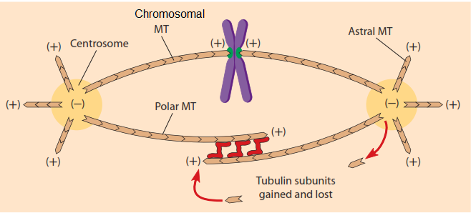
How Does It Work? 1 of 2
Remember that MTs have polarity: a plus (+) and minus (–) end
The minus ends all stay at the centrosomes
The + ends extend as chromosomal MTs, polar MTs and astral MTs
Note that polar MTs can link with each other using special proteins (those red-colored things)

Slide 18
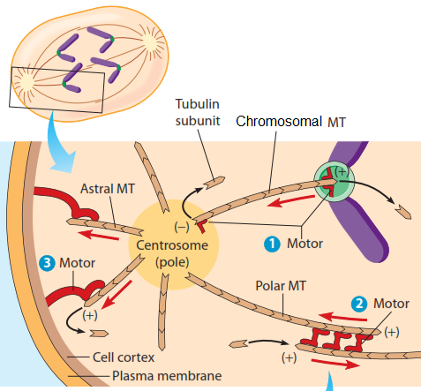
How Does It Work? 2 of 2
Special "motor" proteins remove tubulin subunits both from + and – ends of chromosomal MTs, causing a shortening, pulling chromatid to centrosome
On polar MTs, tubulin subunits are added to the + ends, increasing the length of polar MTs and pushing the asters from each other
On astral MTs, tubulin subunits are removed from the + ends, pulling the aster closer to the plasma membrane
All of these coordinate to produce the anaphase A and B movements observed

Slide 19
Telophase
Onset → chromatids have arrived at spindle poles
spindle disassembly
cytokinesis begins
chromosomes begin to de-compact to form invisible interphase chromatin
nuclear envelopes begin to form in daughter cells
nucleoli reorganize and appear in each nucleus

Slide 20
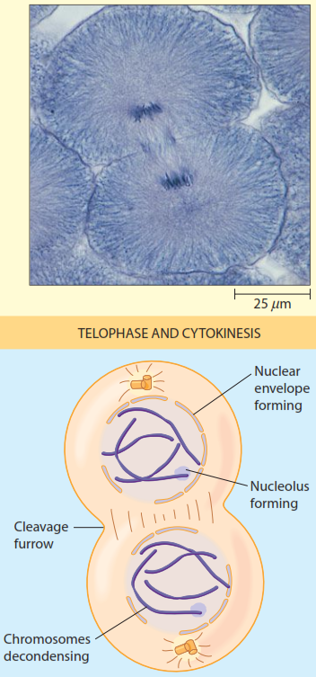
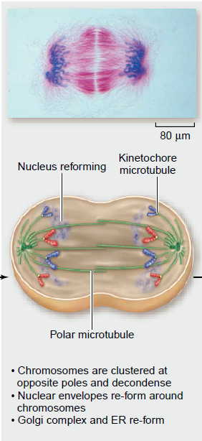
Telophase

Slide 21
Cytokinesis
Onset → late anaphase or early telophase
with nuclear envelope and nucleoli re-formation & chromosome de-condensing
Formation of cleavage furrow: possibly determined by location of spindle
A contractile ring of microfilaments (actin) forms beneath plasma membrane: these interact with unconventional myosin to cause contraction of ring

Slide 22
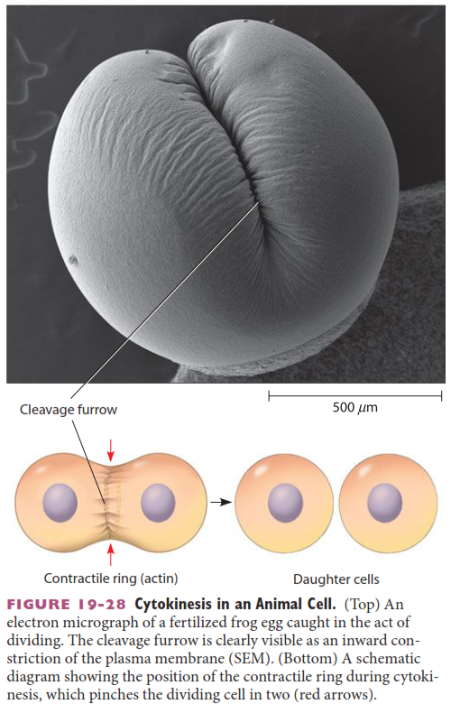
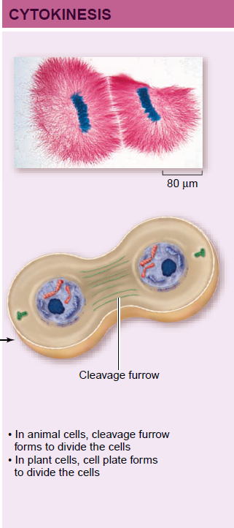

Slide 23
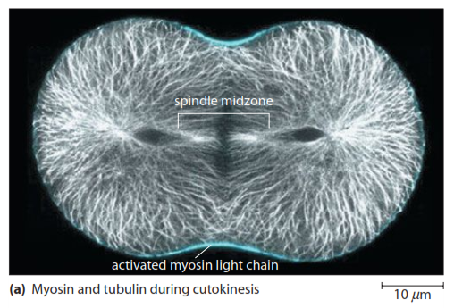
Microtubules are in white
The blue color is the myosin that forms at the cleavage furrow and forms part of the contractile ring
Microfilaments (actin) are not visualized

Slide 24
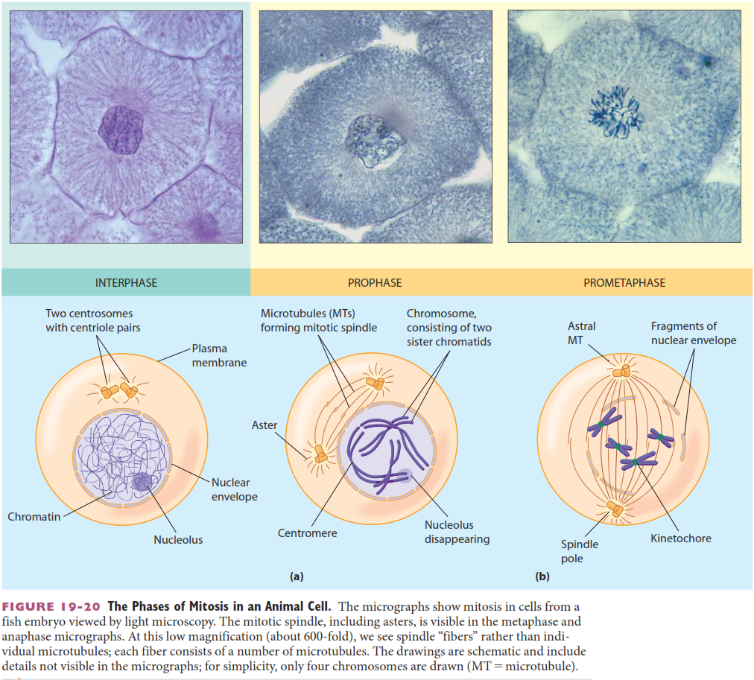

Slide 25
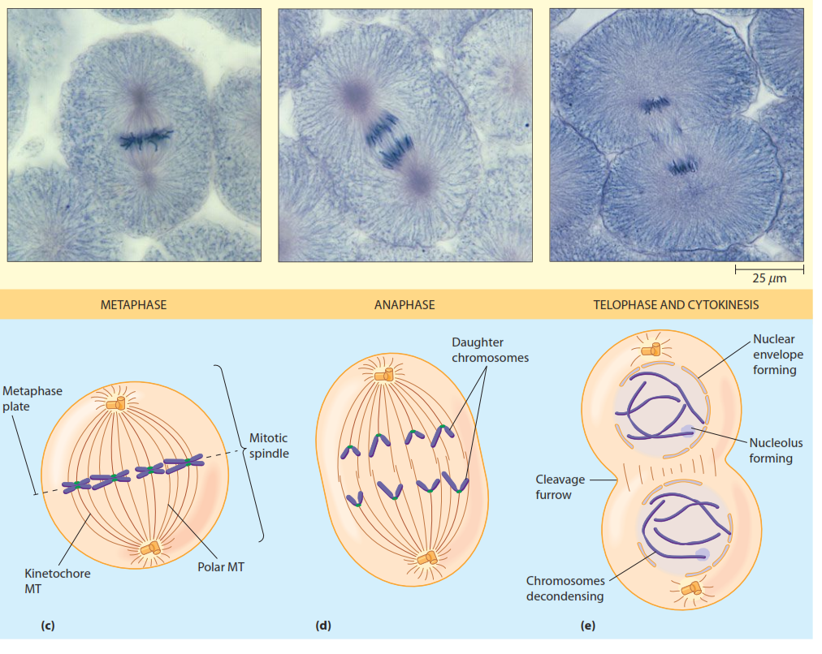

Slide 26
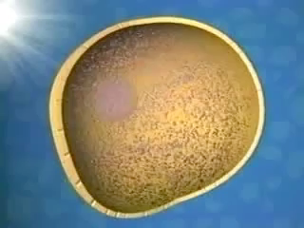

Slide 27
Reading (Sources)
Becker's WotC: pp 570-579
Raven: Chap 10.5

